Slide 1


Fisher-Titus
2023 Open Enrollment Medical Mutual
November 2022

Slide 2
Topics to Cover Today
Important things to know about Medical Mutual
Network Review
Plan Review
  Medical and Prescription Drug Benefits
  Consumer Driven Health Products
    HSA and FSAs
    Vision- VSP Vision Savings Pass for Medical Mutual Members
Member Tools and Resources
Reminders
Notes:
These are modules – customize as needed.
Customize information on the agenda and in the deck based on:
New or renewal group
Which products or services they are purchasing

Slide 3
Network Review

Slide 4
Tiered Provider Network
Tier 1- Fisher Titus Providers & Facilities
Tier 2 – North Coast Healthcare Collaborative
  The Bellevue Hospital
  Firelands Regional Health Center
  H B Magruder
Tier 3 – Medical Mutual SuperMed Providers
  Access to the CIGNA® PPO for members residing or traveling outside of the SuperMed service area
Tier 4 – Out of Network
Notes:
TIER 1: When you receive care at Fisher-Titus, you receive the highest level of benefits. Fisher-Titus providers include Fisher-Titus and affiliated physicians. Choosing to receive your medical care through the use of Fisher-Titus facilities and affiliated providers ensures those payments go directly to our health care system further strengthening and building our future. This allows Fisher-Titus to remain an independent local health care organization. NOTE: Services that cannot be performed at Fisher-Titus Medical Center will not be covered as Tier 1. These services will be covered in the applicable Tier depending on the provider/network. • TIER 2: You receive a higher level of coverage than Tier 3 when you receive care from Magruder, Firelands, and Bellevue hospitals, facilities and providers who are in the North Coast Healthcare Collaborative providers (NCHC) network. Fisher-Titus joined the NCHC to offer services to our plan participants at a lower deductible, coinsurance and copays than Tier 3. Support the region by keeping healthcare dollars local. • TIER 3: You receive a higher level of coverage than Tier 4 when you receive care from other providers who are in the Medical Mutual SuperMed PPO network. The MMO SuperMed network offers broad network access and a national network to Cigna for members residing or traveling outside of Ohio. • TIER 4: When you receive care out-of-network, you receive the lowest level of benefits and can be balance billed

Slide 5



Find a Doctor or Hospital in Your Network
You have choices when looking for an in-network doctor or hospital before and after you enroll
24/7 digital access
  Download our mobile app on your smart phone or visit MedMutual.com
Call our friendly and helpful Customer Care team for assistance
  Mon. – Thurs. – 7:30 a.m. to 7:30 p.m. (EST)
  Fri. – 7:30 a.m. to 6:00 p.m. (EST)
  Sat. – 9:00 a.m. to 1:00 p.m. (EST)
  1-800-586-4509
Notes:
Customize the phone number for the group, if needed.

Slide 6
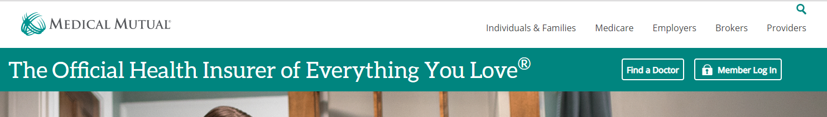
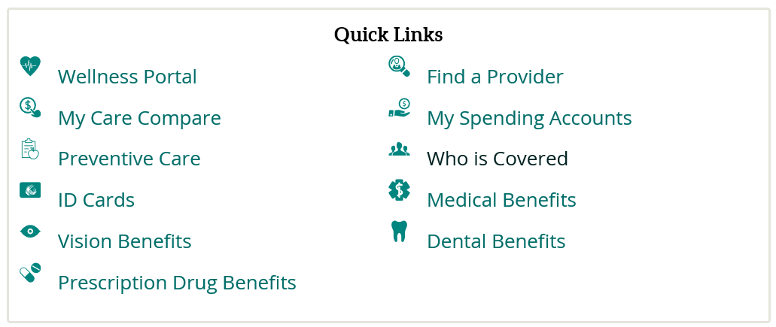
Find a Provider Tool
Log into My Health Plan at www.medmutual.com
Scroll to bottom of page to Find a Provider
Notes:
Renewal Group Slide

Slide 7
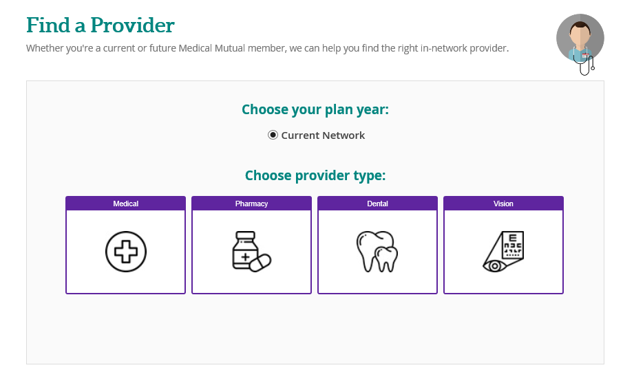
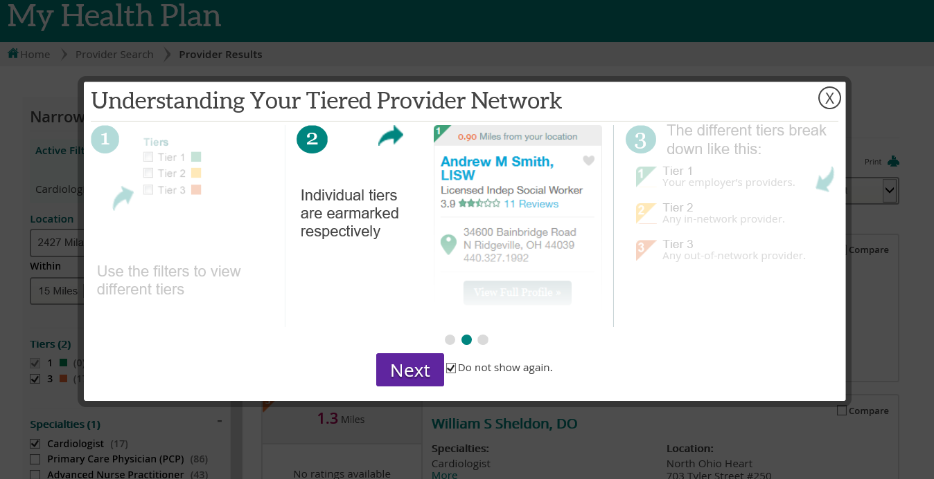
Find a Provider Tool (Renewal)
System will default to your current network
Notes:
Renewal Group Slide

Slide 8
Plan Review

Slide 9
Medical Traditional Copay Plan
Benefits | Fisher Titus (Tier 1) | NCHC (Tier 2) | SuperMed (Tier 3) | Non-Network (Tier 4)
Deductible (Individual/Family) | $250/$500 | $750/$1,500 | $1,500/$3,000 | $3,000/$6,000
Coinsurance | 85% | 75% | 70% | 50%
Coinsurance - Excludes Ded (Individual/Family) | $4,250/$8,500 | $6,250/$12,500 | $6,650/$13,300 | No Limit
Maximum Out of Pocket (Individual/Family) | $8,150/$16,300 | $8,150/$16,300 | $8,150/$16,300 | No Limit
Primary Care Visit | $20 copay then 100% | $30 copay then 100% | $40 copay then 100% | 50% after deductible
Specialist Visit | $30 copay then 100% | $50 copay then 100% | $60 copay then 100% | 50% after deductible
Inpatient Services | 85% after deductible | 75% after deductible | 70% after deductible | 50% after deductible
Urgent Care Visit | Not Applicable | $75 copay then 100% | $150 copay then 100% | 50% after deductible
Emergency Room (True Emergency) | $250 copay

Slide 10
Prescription Drug – Copay Plan Only
 |  |  | Days Supply
Deductible $200 Single - $400 Family
Retail Fisher-Titus (Tier 1) |  | Walgreens Advantage (Tier 2 )
Generic | Lesser of $5 copay or cost of drug | Lesser of $15 copay or cost of drug | 30
Preferred Brand | 30% | 40% | 30
Non-Preferred Brand | 30% + $15 copay | 40% + $45 copay | 30
Specialty Drug | 30% + $15 copay | 30% + $75 copay | 30
Home Delivery | (Tier 1 ) | (Tier 2 )
Generic | Lesser of $10 copay or cost of drug | Lesser of $30 copay or cost of drug via ESI Mail Order Only | 90
Preferred Brand | 30% | 40% via ESI Mail Order Only | 90
Non-Preferred Brand | 30% + $30 copay | 40% + $90 copay via ESI Mail Order Only | 90
10

Slide 11
Medical Qualified High Deductible/HSA Plan
Benefits | Fisher Titus (Tier 1) | NCHC (Tier 2) | SuperMed (Tier 3) | Non-Network (Tier 4)
Deductible (Individual/Family) | $3,000/$6,000 | $3,500/$7,000 | $4,000/$8,000 | $6,000/$12,000
Coinsurance | 85% | 75% | 70% | 50%
Coinsurance - Excludes Ded (Individual/Family) | $1,200/$2,400 | $2,400/$4,800 | $2,900/$5,800 | No Limit
Maximum Out of Pocket (Individual/Family) | $6,900/$13,800 | $6,900/$13,800 | $6,900/$13,800 | No Limit
Primary Care Visit | 85% after deductible | 75% after deductible | 70% after deductible | 50% after deductible
Specialist Visit | 85% after deductible | 75% after deductible | 70% after deductible | 50% after deductible
Inpatient Services | 85% after deductible | 75% after deductible | 70% after deductible | 50% after deductible
Urgent Care Visit | Not Applicable | 75% after deductible | 70% after deductible | 50% after deductible
Emergency Room (True Emergency) | $85% after deductible
Prescription Drug | After Deductible Copay/Coinsurance

Slide 12
Prescription Drug – After HSA deductible is met
 |  |  | Days Supply
After HSA deductible is met
Retail Fisher-Titus (Tier 1) |  | Walgreens Advantage (Tier 2 )
Generic | Lesser of $5 copay or cost of drug | Lesser of $15 copay or cost of drug | 30
Preferred Brand | 30% | 40% | 30
Non-Preferred Brand | 30% + $15 copay | 40% + $45 copay | 30
Specialty Drug | 30% + $15 copay | 40% + $75 copay | 30
Home Delivery | (Tier 1 ) | (Tier 2 )
Generic | Lesser of $10 copay or cost of drug | Lesser of $30 copay or cost of drug via ESI Mail Order Only | 90
Preferred Brand | 30% | 40% via ESI Mail Order Only | 90
Non-Preferred Brand | 30% + $30 copay | 40% + $90 copay via ESI Mail Order Only | 90
12

Slide 13
Pharmacy

Slide 14
Walgreens Advantage Network
Fisher-Titus Inhouse Pharmacy
A broad pharmacy network that includes many of the large national and regional chain pharmacies
Over 43,000 pharmacies nationwide
30-day refills at retail pharmacies and 90-day refills through mail order with Express Scripts
Included Major Retail Pharmacies | Excluded Retail Pharmacies
Walgreens Giant Eagle Rite Aid Kroger Discount Drug Mart Marc’s | CVS Target Sams Club

Slide 15
Generic Incentive Program
  The generic incentive program helps you save money while providing the same quality of prescription drugs
  How it works
  If you request a brand name drug when there is a generic equivalent available, you will pay the brand copay plus the difference between the brand and generic costs
Notes:
Check the example and correct the dollar amounts based on the copay, if needed.
Brand copay + difference
Generic copay + difference

Slide 16
Vision – VSP Savings Pass
VSP® Vision Savings Pass is a discount vision program that offers immediate savings on eye care and eyewear. This is not an insurance plan.
  • Access to discounts through a trusted, private-practice VSP network doctor
  • One rate of $50 for an eye exam1
  • Special pricing on complete pairs of glasses and sunglasses
  • 15% savings on a contact lens exam2
  • Unlimited use on materials throughout the year
  • Exclusive Member Extras, like special offers
How to use your VSP Vision Savings Pass
  Find a VSP network doctor at vsp.com or call 800.877.7195
  Tell your VSP network doctor that you’re a VSP member to save immediately on an eye exam1 and eyewear

Slide 17
Health Savings Account (HSA)

Slide 18
Health Savings Account (HSA)
The Medical Mutual HSA provides a more efficient and affordable way to manage your healthcare benefits and your HSA
Medical Mutual Debit Card
  Pay for qualified medical expenses, such as doctor’s visits and prescriptions
  Wealthcare Management (HSA vendor)
Full Online Access 24/7
  Track HSA and investment balances
  Pay for qualified medical expenses
  Invest in mutual fund options
  Report and reissue a lost or stolen debit card
  Access to all the health benefits resources on My Health Plan, such as My Care Compare and Find a Provider
AccountLink Mobile App
  Manage your Medical Mutual HSA on the go

Slide 19
Who is Eligible for a HSA?
Anyone who is:
  Covered by a HDHP
  Not enrolled in Medicare
  Not covered under other health insurance
  Not another person’s dependent
2023 IRS Contribution Limit (includes ER contribution)
  Single -- $3,850
  Family -- $7,750
  Over age 55 “catch up” -- $1,000
  Fisher-Titus contributes $750 for Single, $1,500 all other coverage levels. New HSA $1000/$1,750

Slide 20
HSA Educational Video
Watch a three-minute video that shows how employees can access their Medical Mutual HSA online and perform various functions, such as:
  Checking balances
  Making an HSA deposit
  Filing a claim
  Calculating tax savings
The video is available on YouTube at the following link:
https://youtu.be/TNk-NCUXXQ4
Notes:
Note: For best results, please view the video in Chrome. It does not work in Internet Explorer.

Slide 21
Flexible Spending Accounts (FSA)

Slide 22
Flexible Spending Account (FSA)
A Medical Mutual FSA allows you to pay for eligible medical expenses on a pre-tax basis
You pay for the qualified expenses with your Medical Mutual Debit Card or out of pocket, and submit a claim for reimbursement
Full Online Access 24/7
  Track FSA balances
  View claims
  Report and reissue a lost or stolen debit card
  Integrated with My Health Plan, our secure member website
AccountLink Mobile App
  Manage your Medical Mutual FSA on the go
  View your account balance and profile information
  Submit a claim

Slide 23
Flexible Spending Account (FSA)
Contribution Limit for 2023:
  Medical or Limited Purpose: $3,050
  Dependent Care: $5,000
Contributions are deducted evenly throughout calendar year pay period
Changes are only allowed due to a qualified event (marriage, birth of child etc.)
Medical FSA funds are available at the beginning of the plan year
Dependent Care is available as funds are withdrawn
Roll-over amount for 2023 $610

Slide 24
Flexible Spending Account (FSA)
Flexible Spending/Dependent Care Filing Limits
  Incurred Services: 1/1/22 – 12/31/22
  Submit a Claim by: 3/31/23 for calendar year ending 12/31/22
Access your account online:
  For access you will need to be registered through My Health Plan
    Claims & Balances
    My Spending Accounts
Customer Service Contact:
  By phone: 800-525-9252
  By email: myspendingaccount@medmutual.com

Slide 25
Medical Mutual Tools and Resources

Slide 26
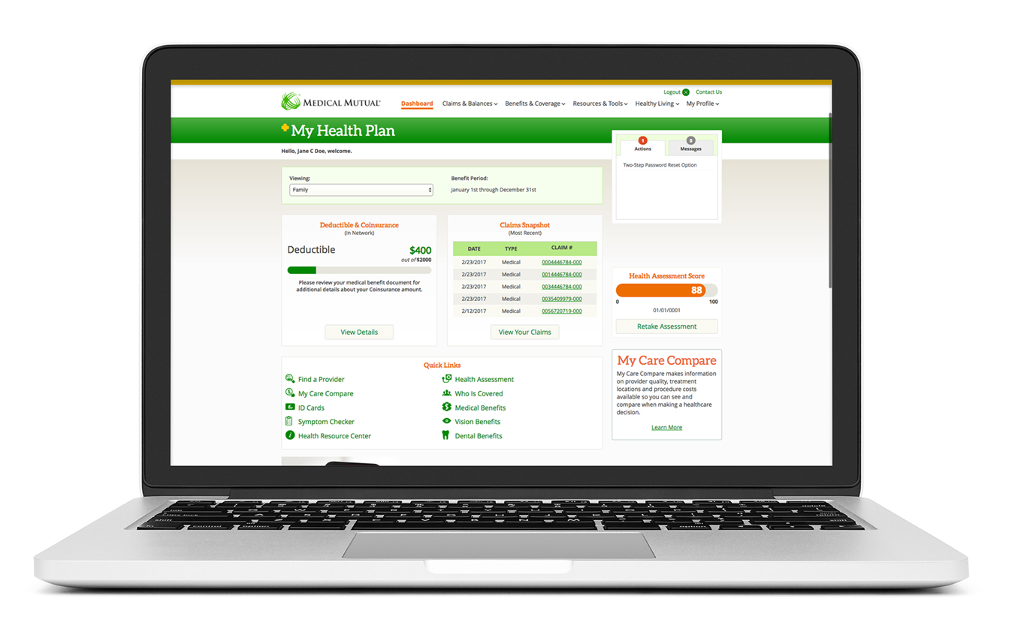
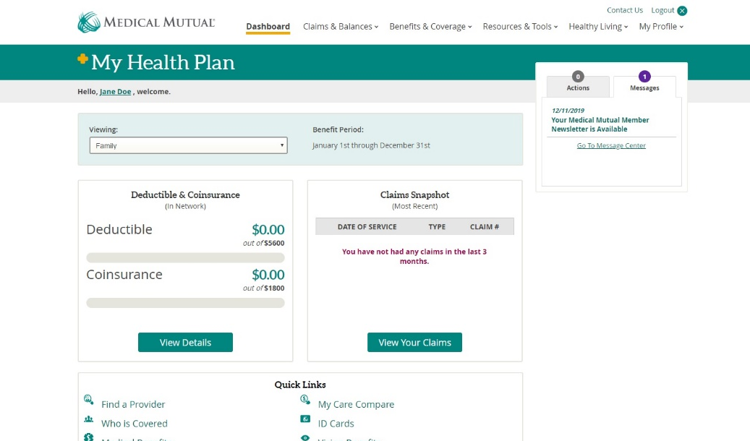
My Health Plan Member Portal
Launch Demo
  Track Expenses
  Out-of-pocket costs, including deductibles and coinsurance
  Message Center
  Custom alerts and messages just for you
  Track Claims
  See current and past claims and status
  Provider Search
  Find providers based on a variety of search criteria
  My Care Compare
  Compare provider costs and quality ratings
Notes:
My Health Plan is our member website. It provides members with account information at their fingertips. A personalized dashboard shows at-a-glance plan information, and provides one-click access to our most used member features.
Deductible and Coinsurance Graph: Members can quickly determine where they are with their out of pocket spending.
Provider Search: Members can find a provider in their area based on a variety of search criteria, including name, specialty, gender, language, hospital affiliation and more.
Claims: Shows recent services submitted by providers, with one click to access additional details and cost breakdowns.
My Care Compare: Members can see what certain tests and procedures cost at different facilities, helping them make healthcare decisions that can save money.
Health Assessment Score: The member can view their health assessment score and easily link over to their personalized wellness portal.
Message Center: We surface and manage important messages for your employees and alert them to actions requiring their attention. (We can partner with you to deliver messages regarding specific campaigns.)

Slide 27
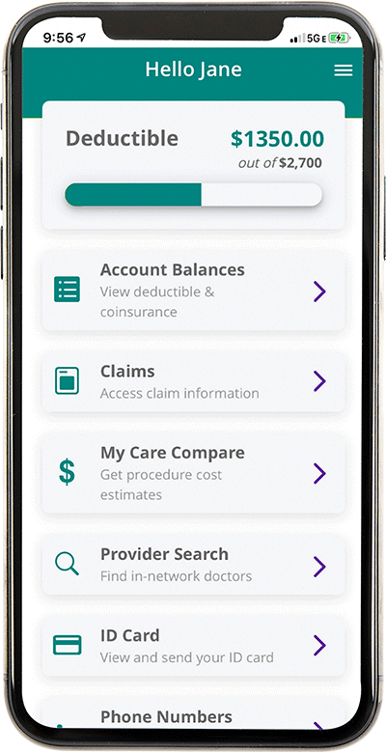

MedMutual Mobile Application
Features
  Swipe to view the back of the card
  Email ID Card
  Fax ID Card
  Contact Us shows phone numbers based on what’s on the ID Card
  Provider Search
  Search by address
  Mirrors My Health Plan provider search
  Many search filters available (gender, language spoken, etc.)
  One click to call
  Add to phone contacts

Slide 28
Chronic Condition Management
Take control of your health: Help for members diagnosed with one or more of the following chronic conditions
Condition | Support Resource | Supplies
Diabetes | Free essential supplies Professional support | Tablet and glucometer to monitor, report symptoms and track blood sugar
Asthma | Professional support | N/A
Chronic Obstructive Pulmonary Disease | Condition management supplies Professional support | Tablet and scale to monitor and report symptoms
Coronary Artery Disease |  | Tablet and home blood pressure monitor to report symptoms and track readings
Heart Failure |  | Tablet and scale to monitor and report symptoms and weight

Slide 29


WW® Discount Program
  Members will receive an upfront discount on monthly memberships
  Discount is nearly 50% savings on the cost of a standard WW membership and equals about $150 over the course of a year
  Discounts available for Digital, Workshop + Digital and WW for Diabetes
  Monthly discount will continue until members disenroll from the program or terminate coverage with Medical Mutual
Notes:
Note: WW is formerly known as Weight Watchers.

Slide 30

Fitness and Healthy Living Discounts
Special membership rates to popular fitness centers/organizations through our partnership with GlobalFit
  Anytime Fitness, 24-Hour Fitness, CrossFit, Curves and more
Discount programs for healthy living products
  AmericanFitness.net
  Safe Beginnings for child-proofing your home
  YogaAccessories.com
  Beltone Hearing Aids
  Vitamix

Slide 31
Quit Line
Tobacco Cessation Program
  Talk with a coach by phone as little or as much as you need. Your coach knows what you’re going through and can help you develop a realistic quit plan that will work for you, even when things get tough
You can also access
  Quit tobacco medications, including over-the-counter or prescription medications
  Quit Guide that breaks down the five steps to quitting
  Texts with reminders and tips to keep you motivated on your journey

Slide 32

24/7 Nurse Line Access
Immediate consultation with a nurse is just a phone call away
The nurse will:
  Listen to your concerns and provide an assessment of the situation
  Provide easy-to-understand explanations about medical tests and results
  Talk through self-care for treating minor conditions at home
  Help determine if the emergency room is the right place of care
  Follow up later to see how you’re feeling

Slide 33
Wrap up

Slide 34
Helpful Resources
Visit MedMutual.com
  Look up doctors and hospitals
  Check out My Health Plan
  Contact our Customer Care team for help and information at 1-800-586-4509
  Convenient hours of operation (all Eastern Time)
    Monday – Thursday 7:30 a.m. – 7:30 p.m.
    Friday 7:30 a.m. – 6:00 p.m.
    Saturday 9:00 a.m. – 1:00 p.m.
Email and chat live with a representative
Notes:
Customize the phone number if the group has a custom phone number.

