Slide 1
HSA 101
Health Saving Accounts: What You Should Know

Slide 2
What We’ll Cover
1
2
3
What an HSA is
HSA Advantages
Get Started

Slide 3
HSA: What is it?
Component 1
Component 2
(High Deductible Health Plan): A PPO Plan which requires you to meet your deducible before insurance pays.
(Health Savings Account): A tax-exempt savings account used to pay for qualified expenses all year long.

Slide 4
HSA: What is it? – Component 1 – Medical Plan
Choice of plan options: | BlueAdvantage HMO | HMO IL | BlueChoice Select PPO | PPO+ | High Deductible PPO (New)
Deductible (All Deductibles Embedded) Individual (In-Network) Family (In-Network) | $250 $500 |  | $1,000 $3,000 |  | $3,000 $6,000
Employee Coinsurance (How much does plan pay after deductible is met) (In-Network) | 100% |  | 80% |  | 80%
Out-of-Pocket Max Individual (In -Network) Family (In -Network) | $1,500 $3,000 Includes Deductible |  | $4,500 ($11,000, $7250) $9,000 Includes Deductible |  | $4,500 $9,000 Includes Deductible
Physician Services (In -Network) Well Adult & Well Child Physician Office Specialist Visit X-Rays / Lab Diagnostics | 100% $30 Copay ($50) $30 Copay BAHMO; $50 Copay HMOIL 100% |  | 100% $30 copay $30 BCS/50 PPO+ copay Deductible then 80% |  | 100% Deductible then 80% Deductible then 80% Deductible then 80%
Telemedicine (MDLive) | No Coverage |  | Based on type of service |  | $48 fee until deductible is reached, then 80%
Emergency Room | $250 Copay (copay waived if admitted) |  | $300 Copay then 80% |  | Deductible then 80%
Prescription Drug Coverage Through CVS / Caremark Retail (Generic / Preferred / Non-Preferred) 30-Day Supply Mail Order (Generic / Preferred / Non-Preferred) 90-Day Supply | $10/40/60 $20/80/120 |  | $10/40/60/80% $50/160/300 |  | Deductible then 80% Certain generic & brand drug maintenance medication covered at 100%, no cost to member

Slide 5
HSA: What is it? – Compenent 2 – Health Savings Account
A tax-exempt savings account funded with tax-free dollars, and used exclusively to pay for qualified medical expenses – current or future
If you enroll in the HD PPO and elect to put $ in the HSA, Thresholds will provide an account through WEX

Slide 6
HSA: Who’s Eligible?
You’re eligible if you’re:
1
Not covered under another medical plan that is not a HDHP
Not entitled to Medicare benefits
Not eligible to be claimed on another person’s tax return medical expenses
2
3

Slide 7
HSA: Contributions
You can contribute to an HSA.
2023 Tax-Free Contribution | Employee Only | Family
IRS 2023 Maximum | $3,850 | $7,750
If you're 55 or older, you can contribute an extra $1,000 to your HSA each year.

Slide 8
HSA: Using the Funds
You can use HSA dollars for:
Medical services
Diagnostic services
Prescriptions
Dental services
Vision services
Long-term care
Medicare copays
And more!
Additional information available on the WEX administration website:
https://www.wexinc.com/insights/benefits-toolkit/eligible-expenses/

Slide 9
HSA: Quick Facts
Even if you change plans, leave Thresholds or retire, the funds are yours to keep forever.
You can use the money in your HSA to pay for the qualified expenses of dependents.
Joint HSAs are not permitted. You can pay for dental and vision expenses too.

Slide 10
HSA: The Good Stuff
Rolling Over Your Costs
Monthly premiums are generally higher on regular PPO plans.
Contribute the difference in premiums to your HSA and you won’t lose those funds. Instead, the money is yours when you need it.
Notes:
Given their higher deductibles (at least $1,400 for employee-only coverage and $2,800 for family coverage), HSA plan premiums are lower.
This allows you to use your HSA to roll over funds that would be lost for good on your premium with a traditional plan.
For example, if the premium on a traditional plan is $25 more per month than a comparable HSA plan, you’d save $300 per year just by contributing the funds to your HSA, allowing you to “roll over” funds from a low-cost healthcare year to a potentially higher cost year

Slide 11
HSA: The Good Stuff
Triple Tax Advantage
You’re not taxed on:
1
Any money you contribute
Any money you spend on qualified expenses
Any interest you gain through your HSA
2
3
Notes:
You’re not taxed on any money you contribute to your HSA, any money you spend from your HSA on qualified medical expenses or on any interest you gain through your HSA bank, making your HSA one of the best ways you can reduce your taxable income.
For example, if you’re in a 25% tax bracket and contribute the maximum amount for employee-only coverage to your HSA ($3,650), you’d save $900 on taxes. Repeat this for 30 years and you’ll have saved over $120,000 on taxes (assuming a 6% average return on your HSA investments).

Slide 12
HSA: The Good Stuff
Powerful Retirement Tool
Notes:
HSAs have a triple tax advantage: you don’t pay taxes on money going in, on interest gained on investments within the account, or when money comes out for qualified medical expenses.
This makes an HSA a viable part of any retirement strategy alongside your 401k.
The left bar bar shows the growth of your money over 20 years if you deposited $3650 per year (the maximum contribution for an individual in 2022) and withdrew $1500 (enough to cover the individual deductible).
Assuming a 6% return on investment, you’d have over $80,000 in the account after 20 years.
The right bar shows the growth of your money if you deposited $7300 per year (the family maximum for 2022) and withdrew $3000 each year (enough to cover the family deductible).
Again assuming a 6% return on investment, you’d have over $165,000 in the account after 20 years.

Slide 13
HSA: Get Started – How to access funds
If you’ve already enrolled in the Thresholds High-Deductible Health Plan, now is your opportunity to contribute to the WEX HSA.
Log in to UKG to begin contributing to your HSA. If you’ve already begun to contribute, you may access your funds via the WEX debit card.

Slide 14
HSA vs. FSA
HSA vs. FSA
 | Health Savings Account (HSA) | Flexible Spending Account (FSA)
Purpose | Pay for current and future medical, dental & vision expenses on a tax-free basis Save for retirement | Medical FSA - pay for current medical, dental & vision expenses on a tax-free basis
Unused Funds | Rollover year to year You own your account –money is yours to keep | Medical - use by end of calendar year – roll $570 from 2022 to 2023 (must reenroll),
Annual Funding Limits | $3,850, $7,750 family 2023 annual maximum contribution ($1,000 catch-up contribution allowed for those members turning 55 or already 55 during the plan year) | $3,050 medical FSA (subject to change)
Funding | Funds are deducted pre-tax Funds are only available once they have been contributed | Funds are deducted pre-tax Full medical FSA amounts available immediately;

Slide 15
HSA – How to access funds

Slide 16
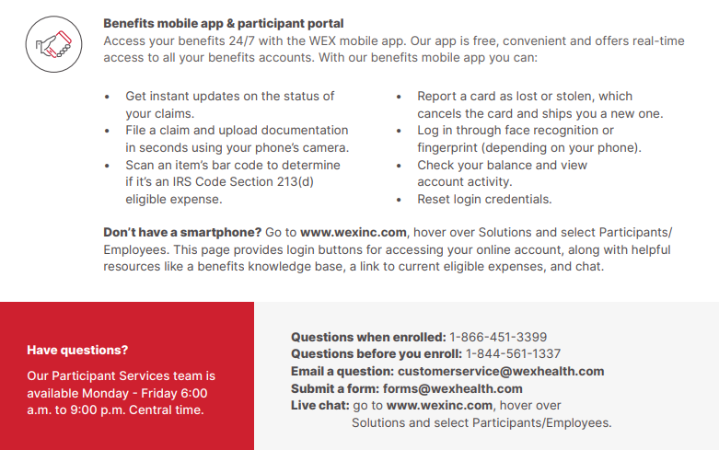
HSA – How to access funds

